Slide 1
DFW Redcross donor predıctıon project

Slide 2
CONTENT
Business Case
Data Acquisition
Data Preparation
Exploratory Data Analysis
Data Visualization
Anomaly Detection
Clustering
Classification

Slide 3
BUSINESS CASE
This project is to help DFW Red Cross Chapter in predicting the donor indicator that guides them to allocate their limited resources more efficiently by contacting the most positive prospects.
DATA ACQUISITION
Past donor data was obtained in CSV format.

Slide 4
DATA PREPARATION
Total number of records: 34508
Total number of duplicates: 2723
Missing Values: Since missing records for each value is >20% we will not use them on the analysis.
Marital Status (24568 records)
Wealth Rating (31799 records)
Academic Degree Level (26902 records)
Donor Date of Birth (21190 records)

Slide 5

EXPLORATORY DATA ANALYSIS

Slide 6
EXPLORATORY DATA ANALYSIS
Dependent Variable: Donor Indicator Flag
Noise Variables
Predictor Variables
DonorUniqueId
MaritalStatus
WealthRating AcademicDegreeLevel
DonorDateOfBirth
CumulativeDonationAmount
DonorAge
ConsecutiveDonorYears
LastFiscalYearDonation
Donation2FiscalYearsAgo
Donation3FiscalYearsAgo
Donation4FiscalYearsAgo
Donation5FiscalYearsAgo
CurrentFiscalYearDonation
DonorPostalCode
GenderIdentity
IsMemberFlag
IsAlumnusFlag
IsParentFlag
HasInvolvementFlag
HasEmailFlag
PreferredAddressType
6

Slide 7

DATA VISUALIZATION
Analyzing data through Tableau

Slide 8
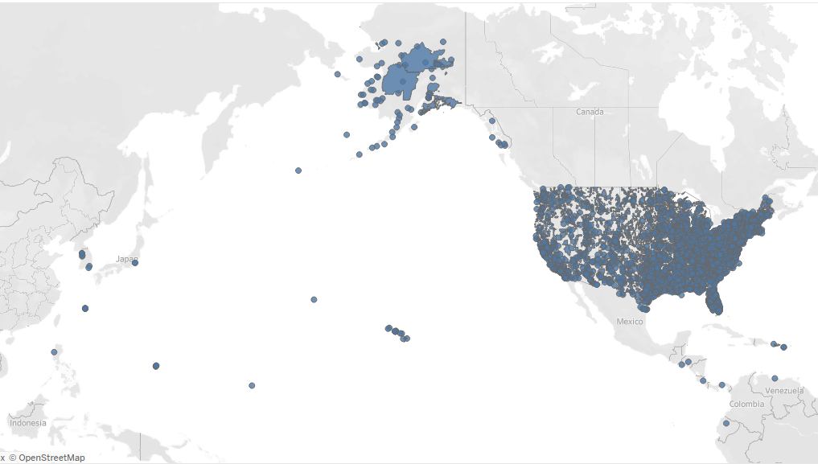
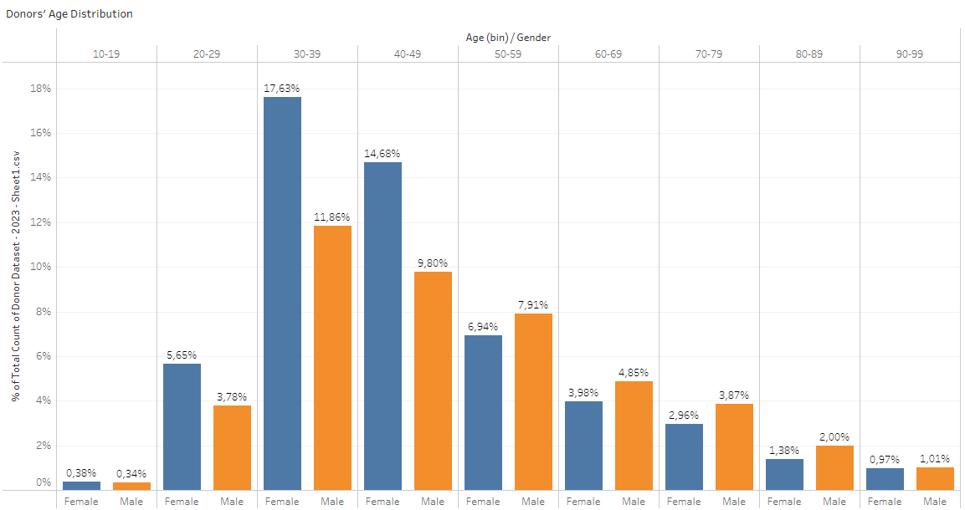
DONOR INDICATORS BY COUNTRIES AND AGES
Most of donors are from the US.
Most of donors are between 30 and 50 years old.

Slide 9
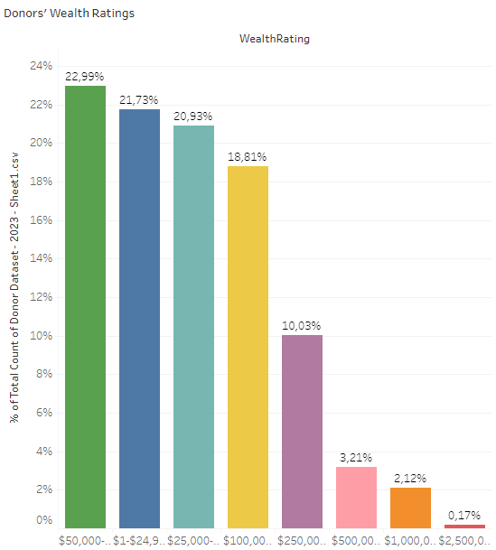
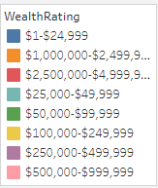
Relatıon between wealth ratıng and donor ındıcator
Donor indication is not related to the wealth rating.

Slide 10
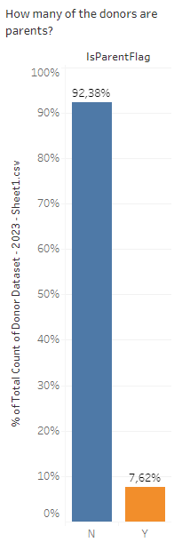
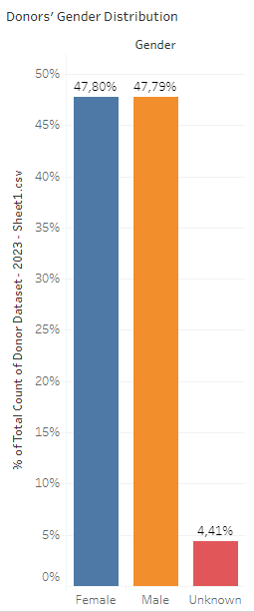
DONOR INDICATORS BY GENDER AND BEING PARENT
Nonparents donate 12 times more than parents.
Females and males donate equally.

Slide 11
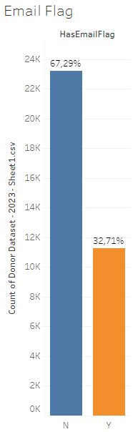
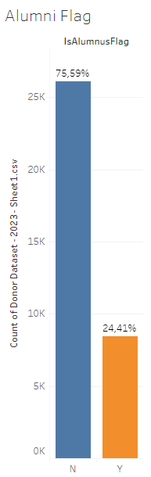
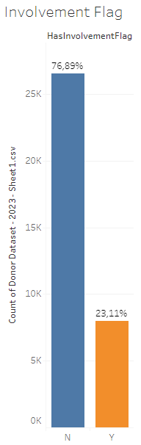
Donor ındıcators by emaıl, ınvolvement and alumnı flags
Feature Explanations
HasEmailFlag: A binary flag indicating whether the organization has an email address for the donor.
IsAlumnusFlag: A binary flag indicating whether the donor is an alumnus of the organization.
HasInvolvementFlag: A binary flag indicating whether the donor has been involved in the organization's activities or events.
Key Highlights
People without emails within the organization donate more. That gives the clue of these people are first time donors.
Non-alumni people donate more than alumnis.
People don’t get involved organization’s activities donate more. This way people who doesn’t know the organization before donate more.

Slide 12
ANOMALY DETECTION and clusterıng

Slide 13
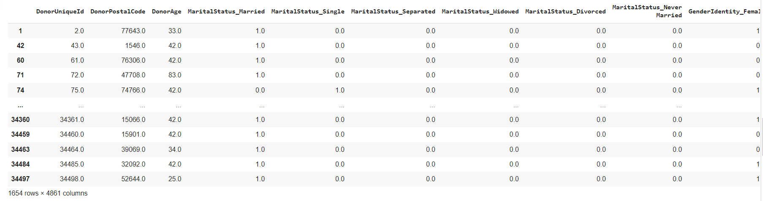
ANOMALY DETECTION
Anomaly is detected on the 1654 records.

Slide 14

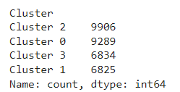
CLUSTERING
Kmeans alogrithm is used to build a clustering model.
Number of Clusters and the Count of Assigned Data Points:

Slide 15
CLASSIFICATION
ML Algorithms and Algorithm Selection
Confusion Matrix
Chi-square Test Analysis

Slide 16
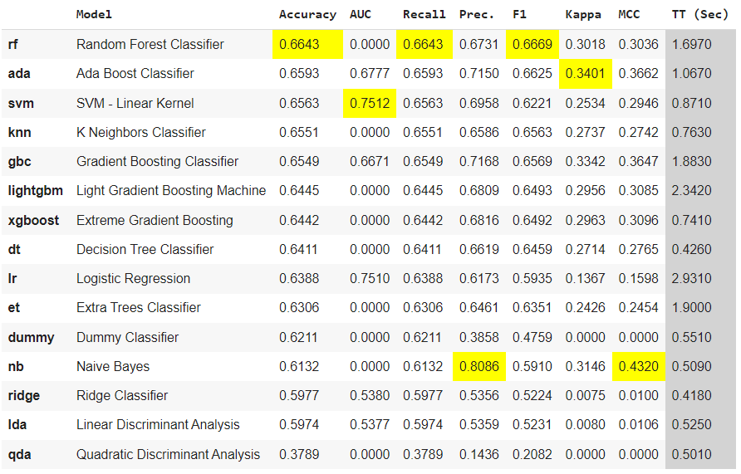
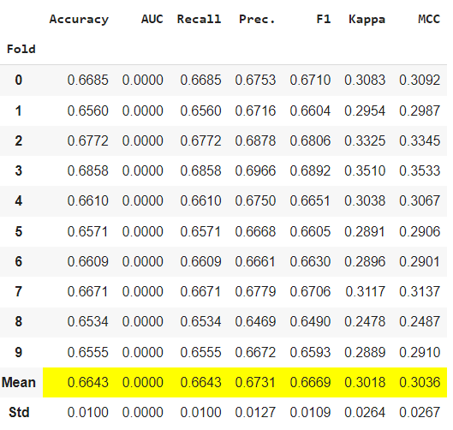
ALGORITHM SELECTION FOR DONOR INDICATOR
Comparison of ML Algorithms
Metrics for Random Forest

Slide 17
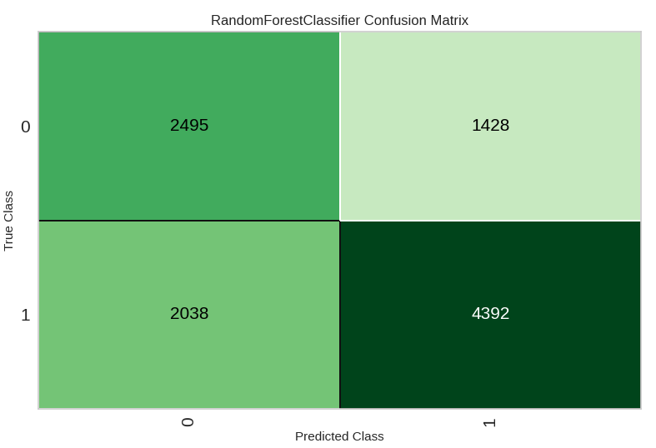
CONFUSION MATRIX FROM RANDOM FOREST
Not Donor
Donor
Actual number of people who were Donor =21,433 and Not Donor = 13,075
A total of 10,353 predictions were made by the model in the confusion matrix.
Out of the total predictions, the model made 5,820 predictions as Donor and 4,533 predictions as Not Donor.
The model correctly predicted 4,392 as Donor, and 2,495 as Not Donor.
The model falsely predicted 1,428 as Donor and 2,038 customers as Not Donor.
Correctly predicted as Not Donor
Falsely predicted as Donor
Not Donor
Falsely predicted as Not Donor
Correctly predicted as Donor
Donor

Slide 18
Donor chı-squared test analysıs
Chi-Squared Test Analysis was performed to identify list of features which impact the std score.
‘Is Member Flag’ is the top categorical feature impacting the Donor Std Score.
Top numerical features impacting the Donor Std Score:
1. Consecutive Donor Years
2. Donation 4 Fiscal Years Ago
3. Donation 3 Fiscal Years Ago
Least impacting features on the Donor Std Score: Has Involvement Flag, Gender, Preferred Address Type, Is Alumnus Flag, Is Parent Flag, Has Email Flag, Donor Postal Code, Donor Age

Slide 19
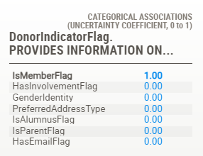
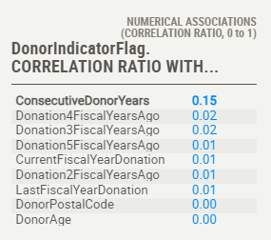
Donor lıner correlatıon tests analysıs
Top 3 influencing factors on AVERAGE STD SCORE of donors are: Is Member Flag, Consecutive Donor Years
‘Is Member Flag’ correlation is very strong, rest of the correlations are weak.

Slide 20
Thank you
Tuba Meric
346-387-2696
twobameric@gmail.com
tubameric.github.io

